Slide 2
The anatomy of a data file
Extents
Pages
PFS/SGAM/GAM/IAM/DIFF/BOOT

Slide 3
Write Ahead Logging
The transaction log is record of truth
Changes are written to the log not the data file
The log is used to rollback transactions
The log is used for recovery of outage

Slide 4

Diagram of QE to Storage Engine (Read)
Query Optimizer
Read Query
Parse
Bind
Results
Optimize
Execute
Storage Engine
Buffer Manager
Log Buffer
Buffer Pool
Log File
Data File
…….

Slide 5

Diagram of QE to Storage Engine (Update)
Query Optimizer
Update Query
Parse
Bind
Results
Optimize
Execute
Storage Engine
Transaction Services
Buffer Manager
Log Buffer
Buffer Pool
Checkpoint/
Lazy Writer
Log File
Data File
…….
…….

Slide 6
Transaction Logging
Logging has two forms:
Logical operation
Before and after “image” of the altered page
The log stores enough to redo or undo any operation
Redo is required in recovery
Undo is a rollback
Rollbacks are also logged, space is reserved during an any operation to ensure a rollback can be completed

Slide 7
Log Buffer
The complete log buffer is flushed to disk on commit
The log writer performs the flush
There is only one process per server, but buffers are per database
The buffer may contain other non committed transactions
Each buffer is up to 60k
Large data modifications will cause the buffer to flush before the commit
User processes showing the WRITELOG wait type are being held up buffer flushes, possible bottleneck at disk

Slide 8
Demo
Notes:
SabinIO.Logging.Demo1

Slide 9
Data File Writes
Dirty data pages are written to disk by either:
Checkpoint
Lazy Writer
Checkpoints are a marker in the log to indicate there are no dirty pages previous to the marker

Slide 10
Checkpoints
Fired when:
Automatically in background by the server, intervals will vary
Timing is based upon the “recovery interval” advanced setting
Simple databases at 70% log full
Also truncates the log (frees up space)
Other types of Checkpoint:
Indirect – caused by database backups, snapshots and cluster failovers
Manual – user invoked checkpoint

Slide 11
Lazy Writer
Background process the writes dirty pages to disk
Tries to write continuous pages (up to 32)
Can be invoked by memory pressure
Can write pages where the change has NOT been committed
Page is latched
No users can modify it until the write is complete
Reads continues

Slide 12
Recovery
Performed during the startup of the server/database
Ensures the consistency of the database before users can access it
3 Phases
Log Analysis – find the last checkpoint (known good state)/first active VLF
Redo – Looks for committed pages that were not flushed to disk before the last shutdown.
Undo – Rollback any uncommitted transactions that have been flushed to disk

Slide 13
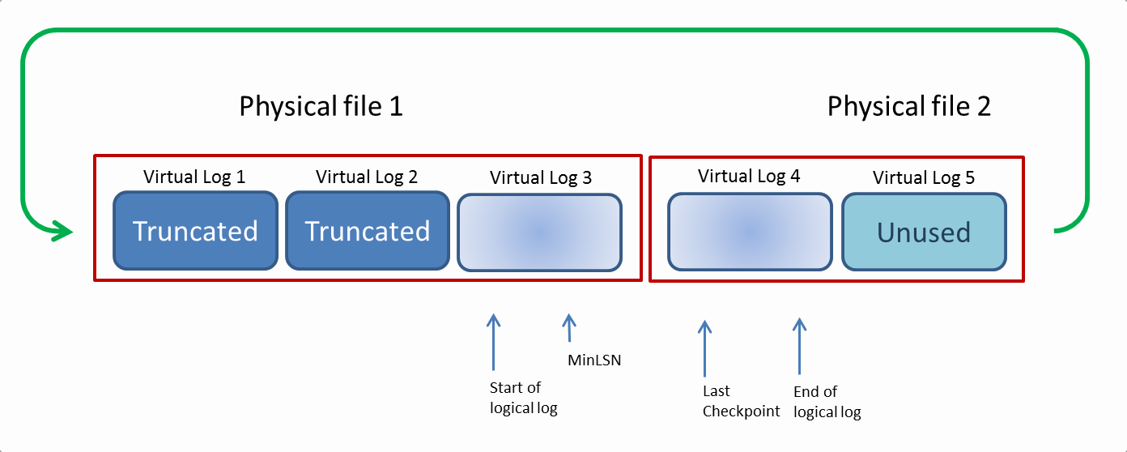
Log Structure
Contains multiple Virtual Log Files (VLF’s)
These vary in size and number
Writing to the VLF is always sequential for performance
At the end of the last VLF it loops back to the first available VLF
Any VLF post the last checkpoint is considered the active portion

Slide 14
Demo
Notes:
SabinIO.Logging.Demo2

Slide 15
Clearing the Log
Features that block log truncation
Replication
Mirroring
CDC
Open Transactions
Backups
See sys.databases log_reuse_wait_desc

Slide 16
Data Integrity
Page Verification
None
Pages are trusted to be valid, totally corrupt pages still cannot be read
Torn Page
Places a bit marker every 512 bytes to show page was fully written
Checksum (default 2005+)
Creates a checksum of the data and writes to header
On read the checksum is verified
When changing to checksum existing pages will not have a checksum
It will resort to torn page checking if it existed
Fix by reindexing

Slide 17
Demo

